Slide 1
AdventureStore Marketing Analysis: Data Presentation
Stanley A. Esezobor

Slide 2
Email: Request for Data Analysis to Improve Marketing Campaign
Hi Data Analyst,
I hope you're doing well. I’m Kelvin, the Marketing Manager at Adventure Stores. We’ve been experiencing challenges with our marketing campaigns and would value your expertise in data analysis to help us pinpoint areas for improvement.
Despite increased marketing investments, customer engagement and conversion rates have declined, and our return on investment isn’t meeting expectations. We need your help to evaluate the effectiveness of our current strategies, uncover opportunities to optimize our efforts, and recommendations to increase conversion rates.
We have data from customer reviews, social media feedback, and campaign performance metrics, which we believe can provide valuable insights. Your analysis will be instrumental in helping us turn things around.
Looking forward to your support. Kelvin Reins
Marketing Manager

Slide 3
Summary of Business Problem / Key Points
Business Problem Summary
AdventureStore, an online retail business, is facing reduced customer engagement and conversion rates despite launching several new online marketing campaigns. They are reaching out to you to help conduct a detailed analysis and identify areas for improvement in their marketing strategies.
Key Points
Reduced Customer Engagement: The number of customer engagements have decreased over time which has led to low ROI
Decreased Conversion Rate : Low conversion rate probably due to decreased in customer engagement
High Marketing Campaign: Increased in campaign expenses
Analysis on customer feedbacks: Understanding customer pain point, behavior, and opinions on products and services for better engagement and conversion rate.

Slide 4
Goals
To Increased Conversion Rate:
Goals: Identify factors affecting conversion rate and provide recommendations to improve it
Insight: Highlight key stages where visitors drop off and suggest ways to optimize the conversion funnel
To Enhanced Customer Engagement:
Goals: Identify the type of contents that attract the highest engagement
Insight: Analyze interaction with various types of marketing contents for enhanced decision making
To Improve Customer Feedback Score:
Goals: Identify common patterns in customer reviews for better/improve decision making
Insight: Analyze customer ratings and feedback to identify recurring positive and negative feedbacks to enable products and service improvement

Slide 5
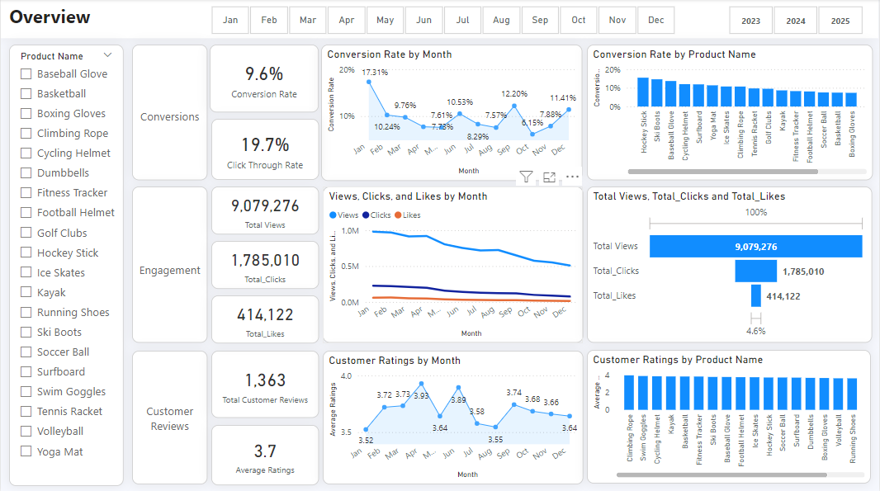
Analysis Overview
Conversion rate:
Conversion rate took a dip from 17.3% in January to 10.2% in February and further down to in May. Although there were rebounds in 7.6% June 10.5% and September 12.2%. There was a consistent upward trend towards the end of the year. Also the click through rate stood at 19.7%, while the conversion rate at 9.6%
It is also note worthy to say that some product has higher conversion rate like Hockey Stick 15.5%, Ski Boots 14.6%, and Baseball Glove 13.7%. Swimming Giggle had the lowest engagement of 5.6%.
Customer Engagement:
Customer engagement shows a steady decline from January to December in Views from over 900k to 510k views, which also reflect drops in Clicks 226k to 75k and Likes 59k to little over 13k.
Customer reviews:
Customer reviews stood steady at 3.7% on average. The highest review was received in April 3.9% and June 3.8%, while the lowest review came in January and August 3.5% each. The rating per product stood slightly steady without any major deep

Slide 6
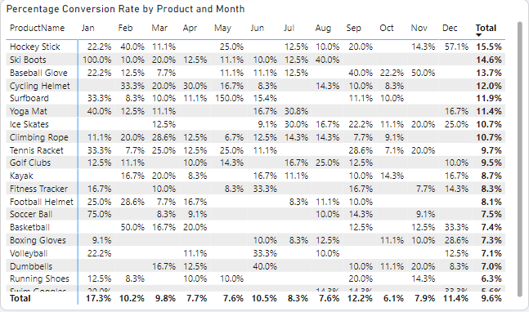
Decrease Conversion Rate
General Trend
The conversion rate generally shows a steady decline from January 17.3% to December 11.4%. It began with a high rate in January to low in mid year April 7.7%, May 7.6%, and August 7.6%. It starts to peak up in Q4.
Highest Conversion Month
The highest conversion rate took place in January 17.3%, which was likely fueled by Ski Boots sale which brought in 100% conversion rate, and also Soccer Ball sale which gave a 75% conversion rate. All in the month of January.
Lowest Conversion Month
The lowest conversion rate was recorded in October with 6.1%, April 7.7%, and May with 7.6%.

Slide 7
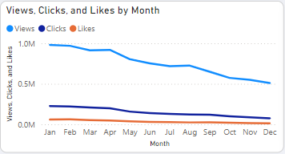
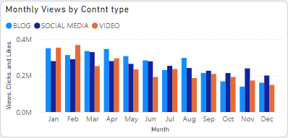
Reduced Customer Engagement
Declining Views:
The views declines steadily from January 980k to March 915k and remained firm till April 919k. Then began to drop continuously from April to December 510k views.
Low Interaction Rate:
The decline in views definitely reflected in clicks and like which shows engagement with the content. Although the view decreased by almost half (from 980k to 510k), The clicks and like were affected more. With clicks decreasing from 226k to 75k, while like dropped from 59k to 13k at the end of the year.
Content Type Performance:
Blog content brought the most views especially at the beginning of the year, but showed a strong dip at 4th quarter. Social media and video maintained a steady but slightly lower views and engagement.

Slide 8
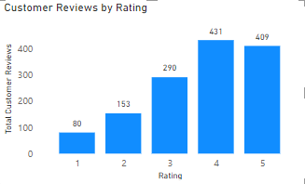
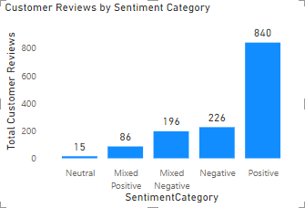
Customer Feedback Analysis
Customer Rating Patterns:
The majority of customer ratings stood 4 to 5 stars, with 431 gave a 4 star rating, and 409 gave a 5 star rating. On the lower end, 80 customers gave 1 star, while 153 gave 2 stars, that means a total of 233 customers where not satisfied.
Customers Sentiment Analysis:
Positive sentiment stood high at 840 which show a high customer satisfaction rate. On the other hand, negative sentiment stood at 226, while a few customers 15 were neutral in their reviews. Mixed negative and mixed positive sentiments stood at a combine total of 282, which show an area to improvement on.
Opportunity for Improvement:
The presence of mixed positive and mixed negative sentiments shows that there is need to convert them into a positive ones. Addressing the concerns of mixed reviews will greatly improve customer satisfaction, and potentially boost overall ratings and lead to more sales.

Slide 9
Goals / Recommendations
Recommendations
Increased Conversion Rate:
To increase conversion rate, it is recommended that you target high performing product categories such as Ski Boots, Baseball Glove, Yoga Mat, Surf Board, and Cycling Helmet. As these will boost total sales up by 10% - 20%, because there are always community behind these activities.
Adopt seasonal promotion and campaign during peak months like January, and September to December, to capitalize on the seasonal trends.
Since there is a high rate of drop off, it is also recommended to occasionally run a brief survey to understand why customer drop off before purchase, and develop way to reduce drop off rate such as recommending other related products.
Enhanced Customer Engagement:
To turn around the decreasing views and engagements, post more engaging content such as videos and user generated contents. Carry out experiments on posts to know the most engaging content format for the audience.
Also, add call-to-action to both boosted contents and non boosted contents on social media and blog posts to keep users engaged. This might increase engagement by 7% - 10% especially during low engagement months like September to December.
Improve Customer Feedback Score:
Address mixed and negative feedbacks by asking customers with negative feedback the reason for their unsatisfaction and ways you can better serve them. Develop improve plan to address this issues.
Consider following up with dissatisfied customers and encourage re-rating in other to boost average rating score above the 4.5 target.
Goals
Increased Conversion Rate:
Goals: Identify factors affecting conversion rate and provide recommendations to improve it
Insight: Highlight key stages where visitors drop off and suggest ways to optimize the conversion funnel
Enhanced Customer Engagement:
Goals: Identify the type of contents that attract the highest engagement
Insight: Analyze interaction with various types of marketing contents for enhanced decision making
Improve Customer Feedback Score:
Goals: Identify common patterns in customer reviews for better/improve decision making
Insight: Analyze customer ratings and feedback to identify recurring positive and negative feedbacks to enable products and service improvement

